Slide 1
In this experiment you will learn to identify 8 different kinds of rocks,
like obsidian, pumice, etc.

Slide 2
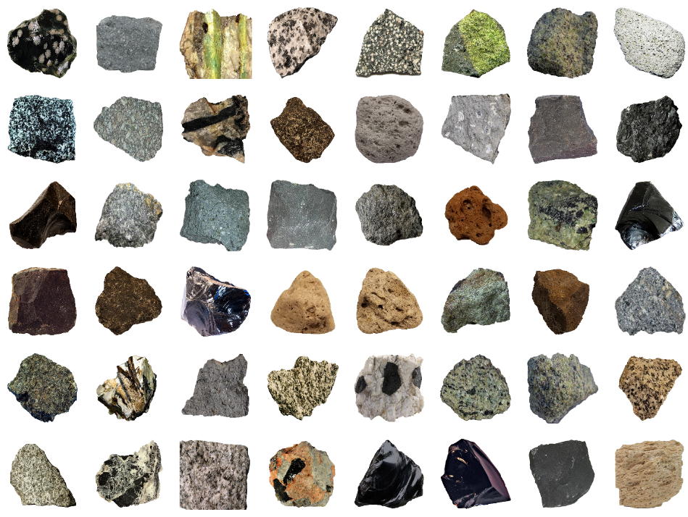
On each trial, you will start by seeing
a grid of rocks, like below.
These are examples of the rocks you will learn to classify.
On each trial, you will use the mouse to click on one of the rocks that you want to learn about.

Slide 3
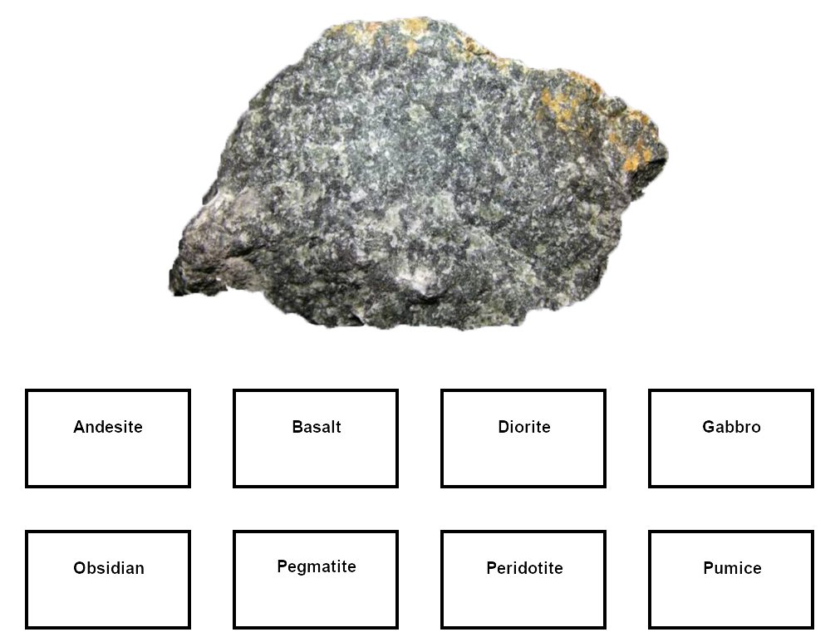
Then you will see an enlarged picture of the rock, with buttons on the screen with the different types, like below.
Make your best guess at identifying the rock by clicking one of the buttons. After you make your selection, the computer will tell you the correct answer.

Slide 4
At first you will be guessing, but by paying attention to the rocks and the correct answers provided by the computer, you should gradually learn to identify the rocks.

Slide 5
After each of the training blocks that we
just described, you will be tested on
what you have learned in a test block. We will explain the test blocks after you complete your first training block.
The experiment consists of 9 cycles of
training and test blocks,
with 16 trials per each block.

Slide 6
Your goal is to learn to correctly classify the rocks into as many of the 8 geological types as you can during the TEST blocks.

Slide 7
Your goal is to learn to correctly classify the rocks into as many of the 8 geological types as you can during the TEST blocks.
The TRAINING blocks are there to help you learn the rock categories, but your performance during the training blocks is not being recorded by the computer.
During training, you shouldn’t waste time selecting rocks from categories that you have already learned. Instead, we recommend that you should select rocks from categories that you still need to learn!

